Slide 1
Project: House Buying System
Yi Zhong
Qingqiao Hu
Qi Dong

Slide 2
Presentation Outline:
Purpose: To build a recommendation system of house renting or buying.
Description: Our project is based on the information from “Weichert”, a website of house renting or buying, and we focus on the houses of New Jersey. We collect the houses’ information, and save them to our system database. We use linear regression to give prediction to the house price according to the preferences provided by users, and provide the concrete property information of houses for users to choose from.

Slide 3
Presentation Outline:
Project Stumbling Block: Information collection
Data processing
Linear Regression
UI Design

Slide 4
Presentation Outline
Future Extensions/ Work:
1) Expanding the System Database to the US, even the world
2) Providing more preferences for users to choose from
3) Building a virtualization of the houses, so that users can get a clear view of similar houses according to the dynamic graph
References: Weichert

Slide 5
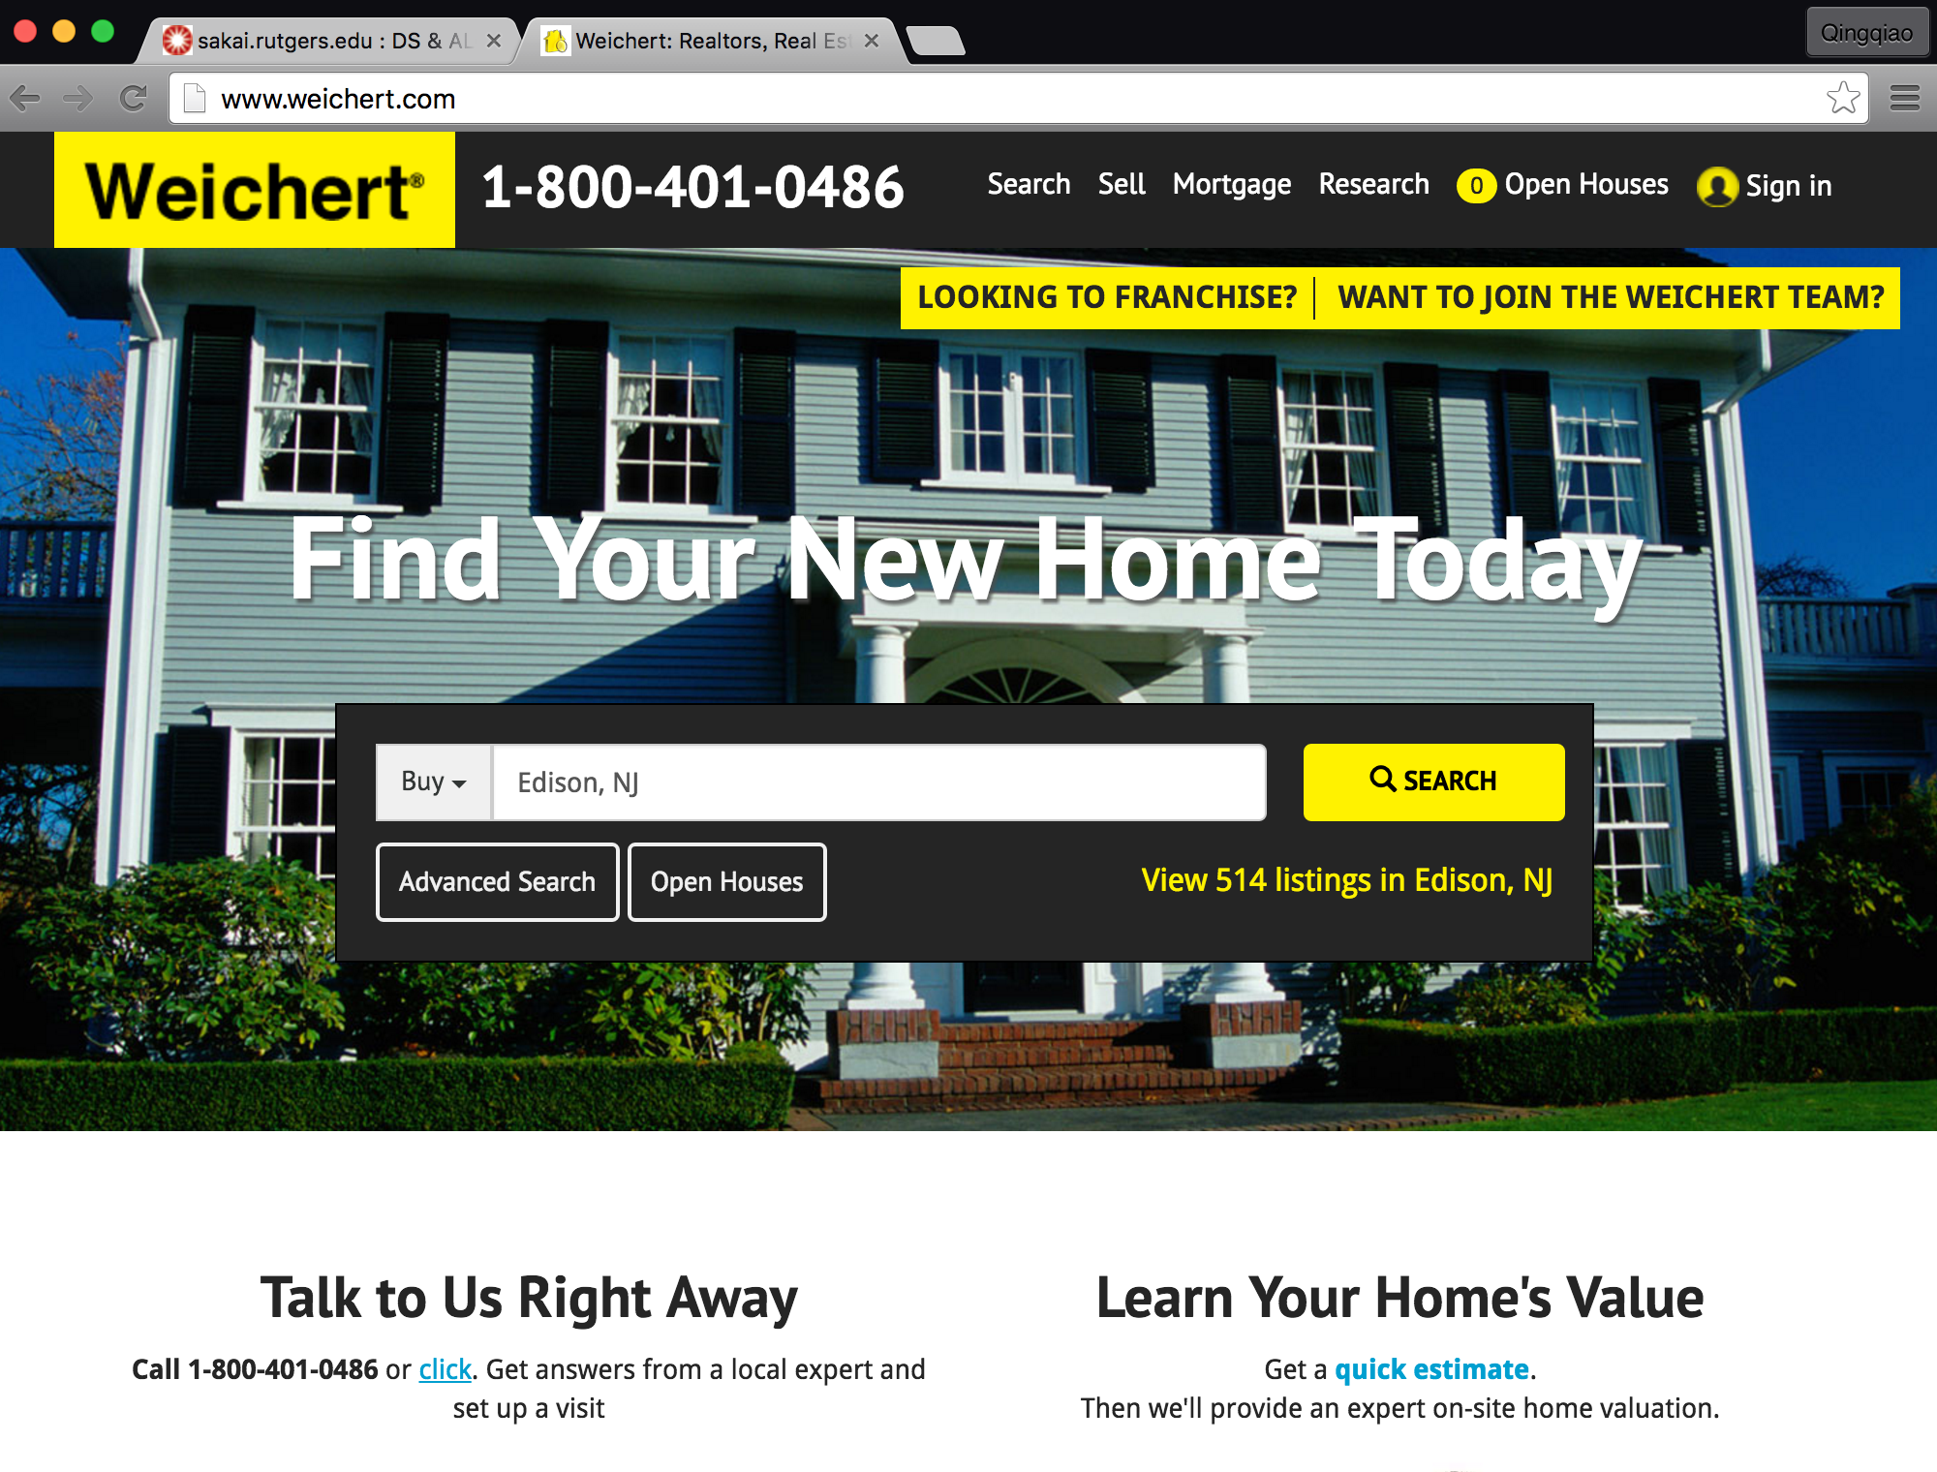
Project Procedure:
We start from collecting the information of Werchert, gathering all the information of New Jersey.

Slide 6
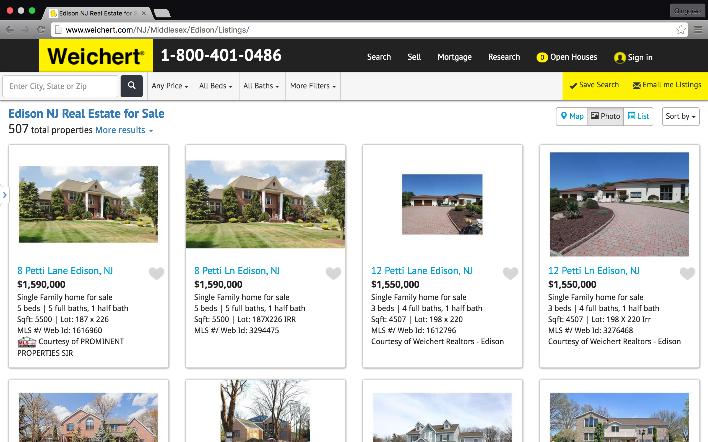
Project Procedure:
For example, we can search the houses’ information of Edison, and there are hundreds of houses that you can see from the picture.
We can collecting all the information by searching the unique WEB ID of each house.

Slide 7
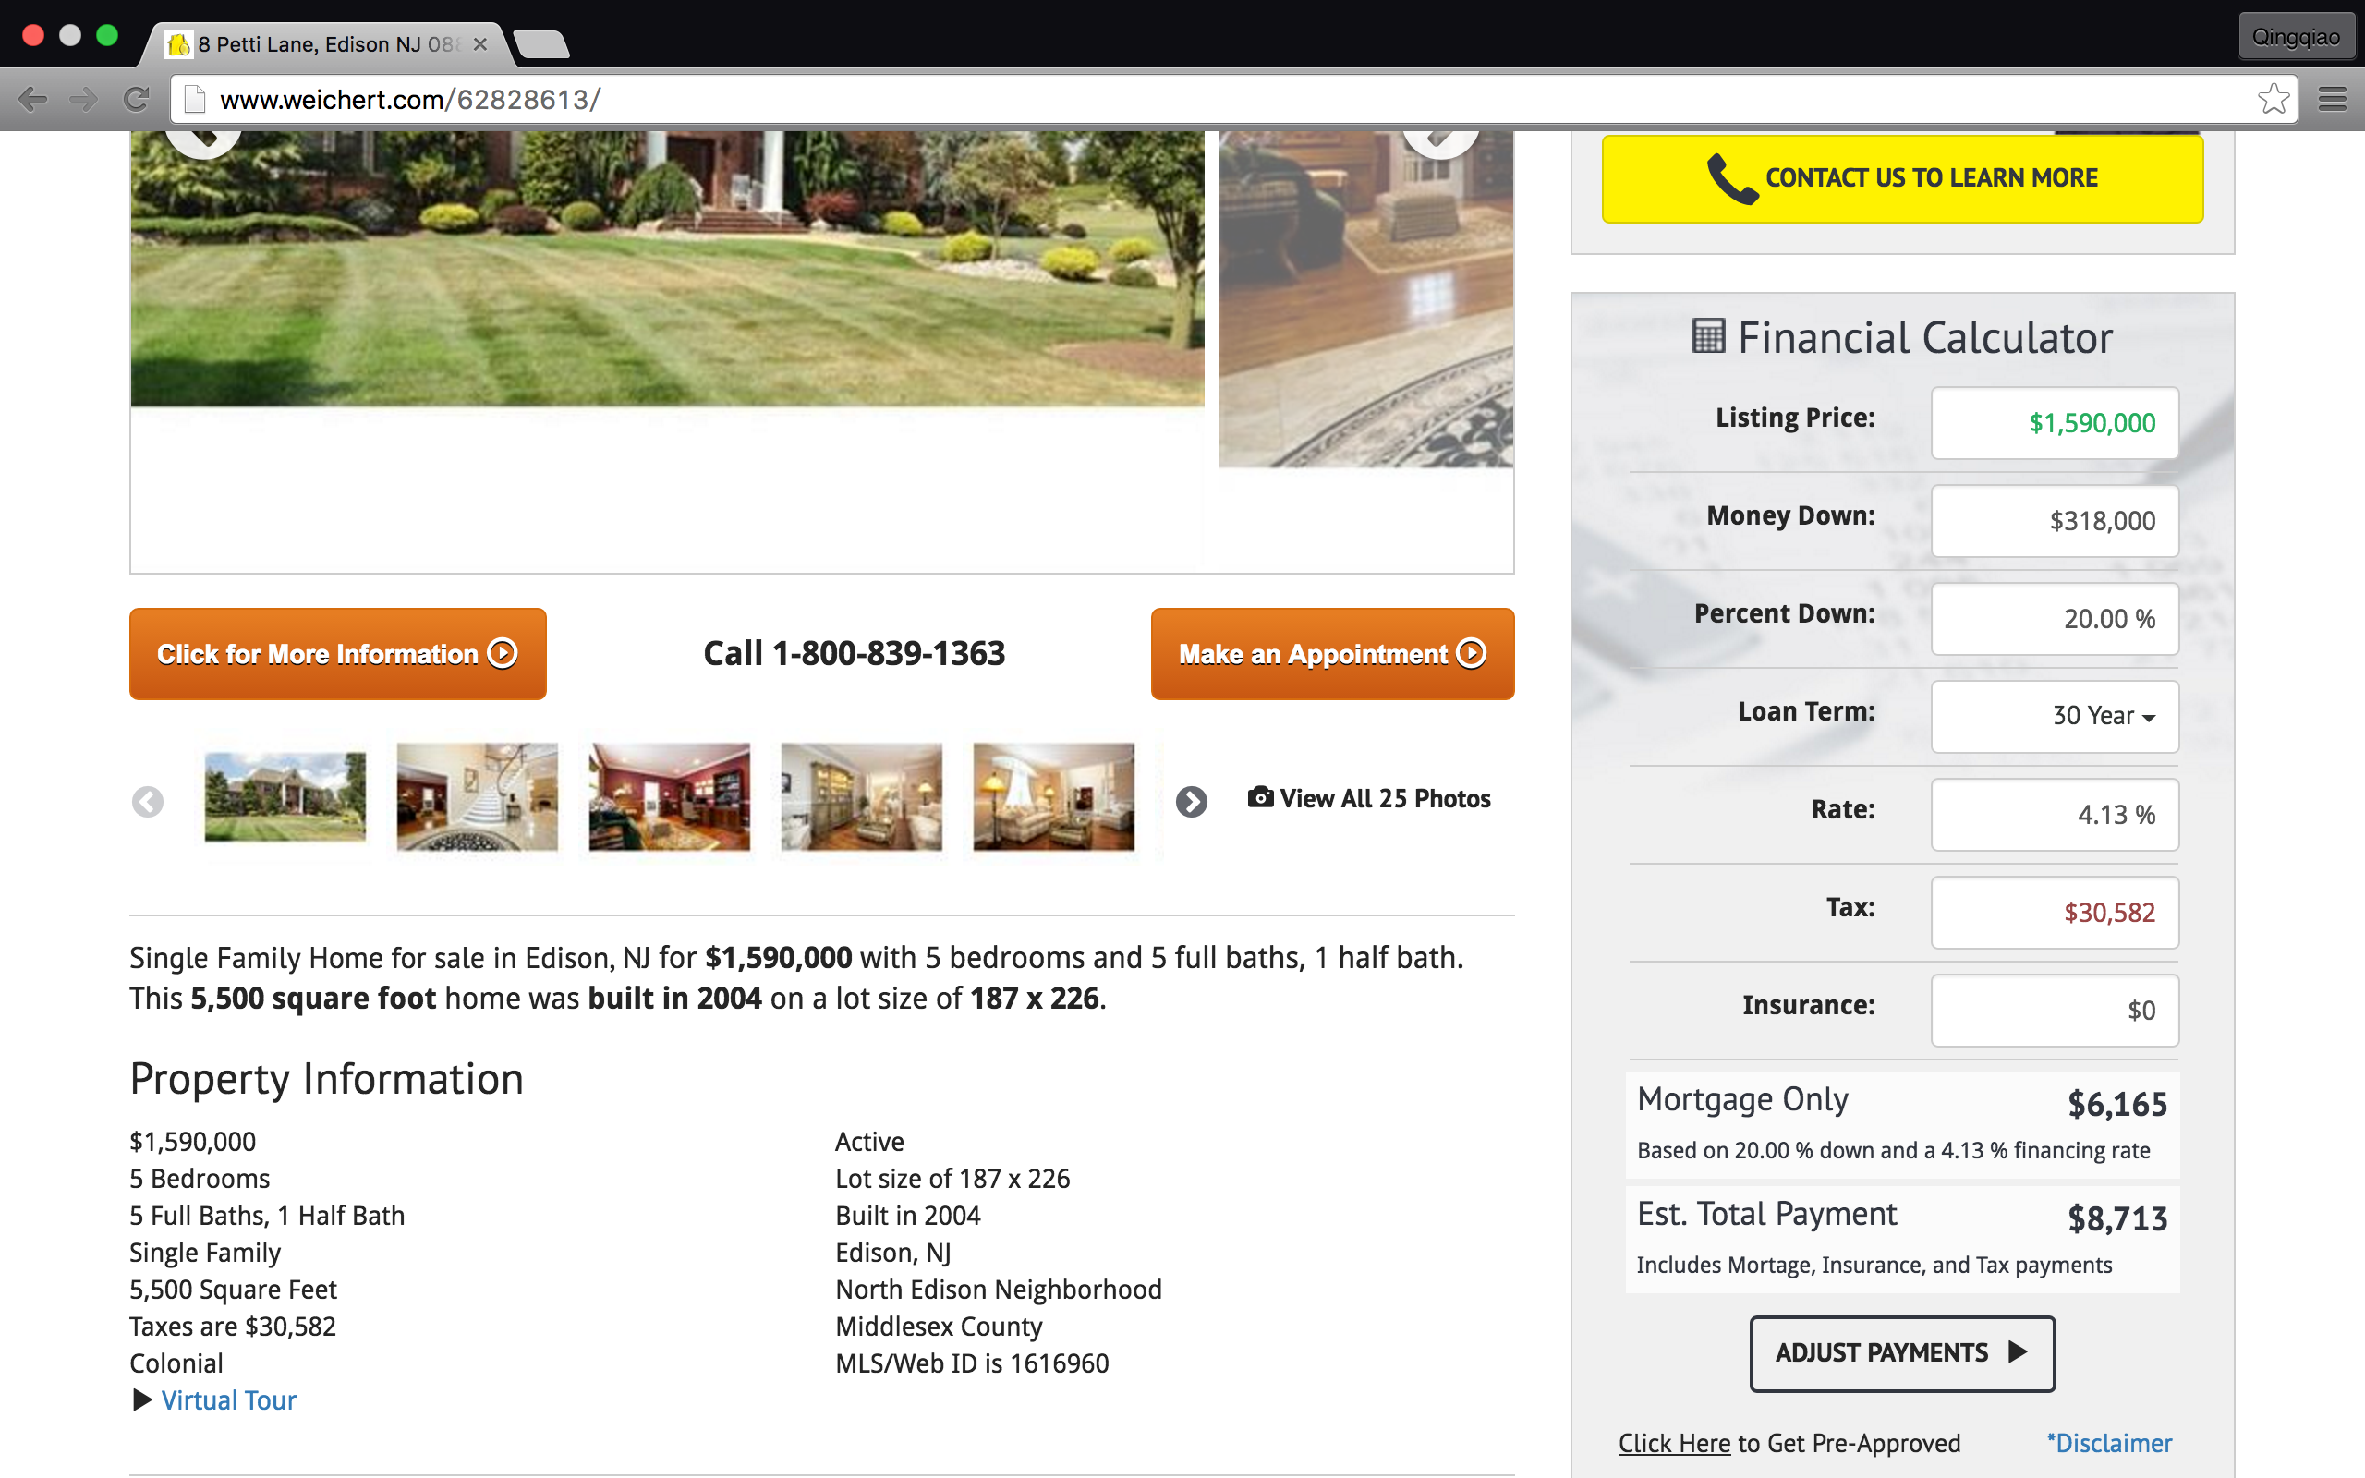
Project Procedure:
When we click the first house in the list, and we can see that all the information of the house is listed in the Property Information. These information is the key to save and sort all the houses in the list.

Slide 8
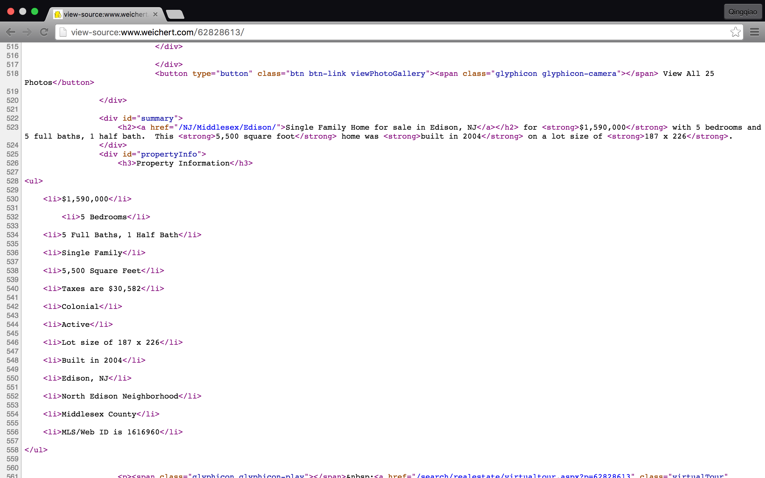
Project Procedure:
Next, what we need to do is to grab the information in the Property Information through crawling.

Slide 9
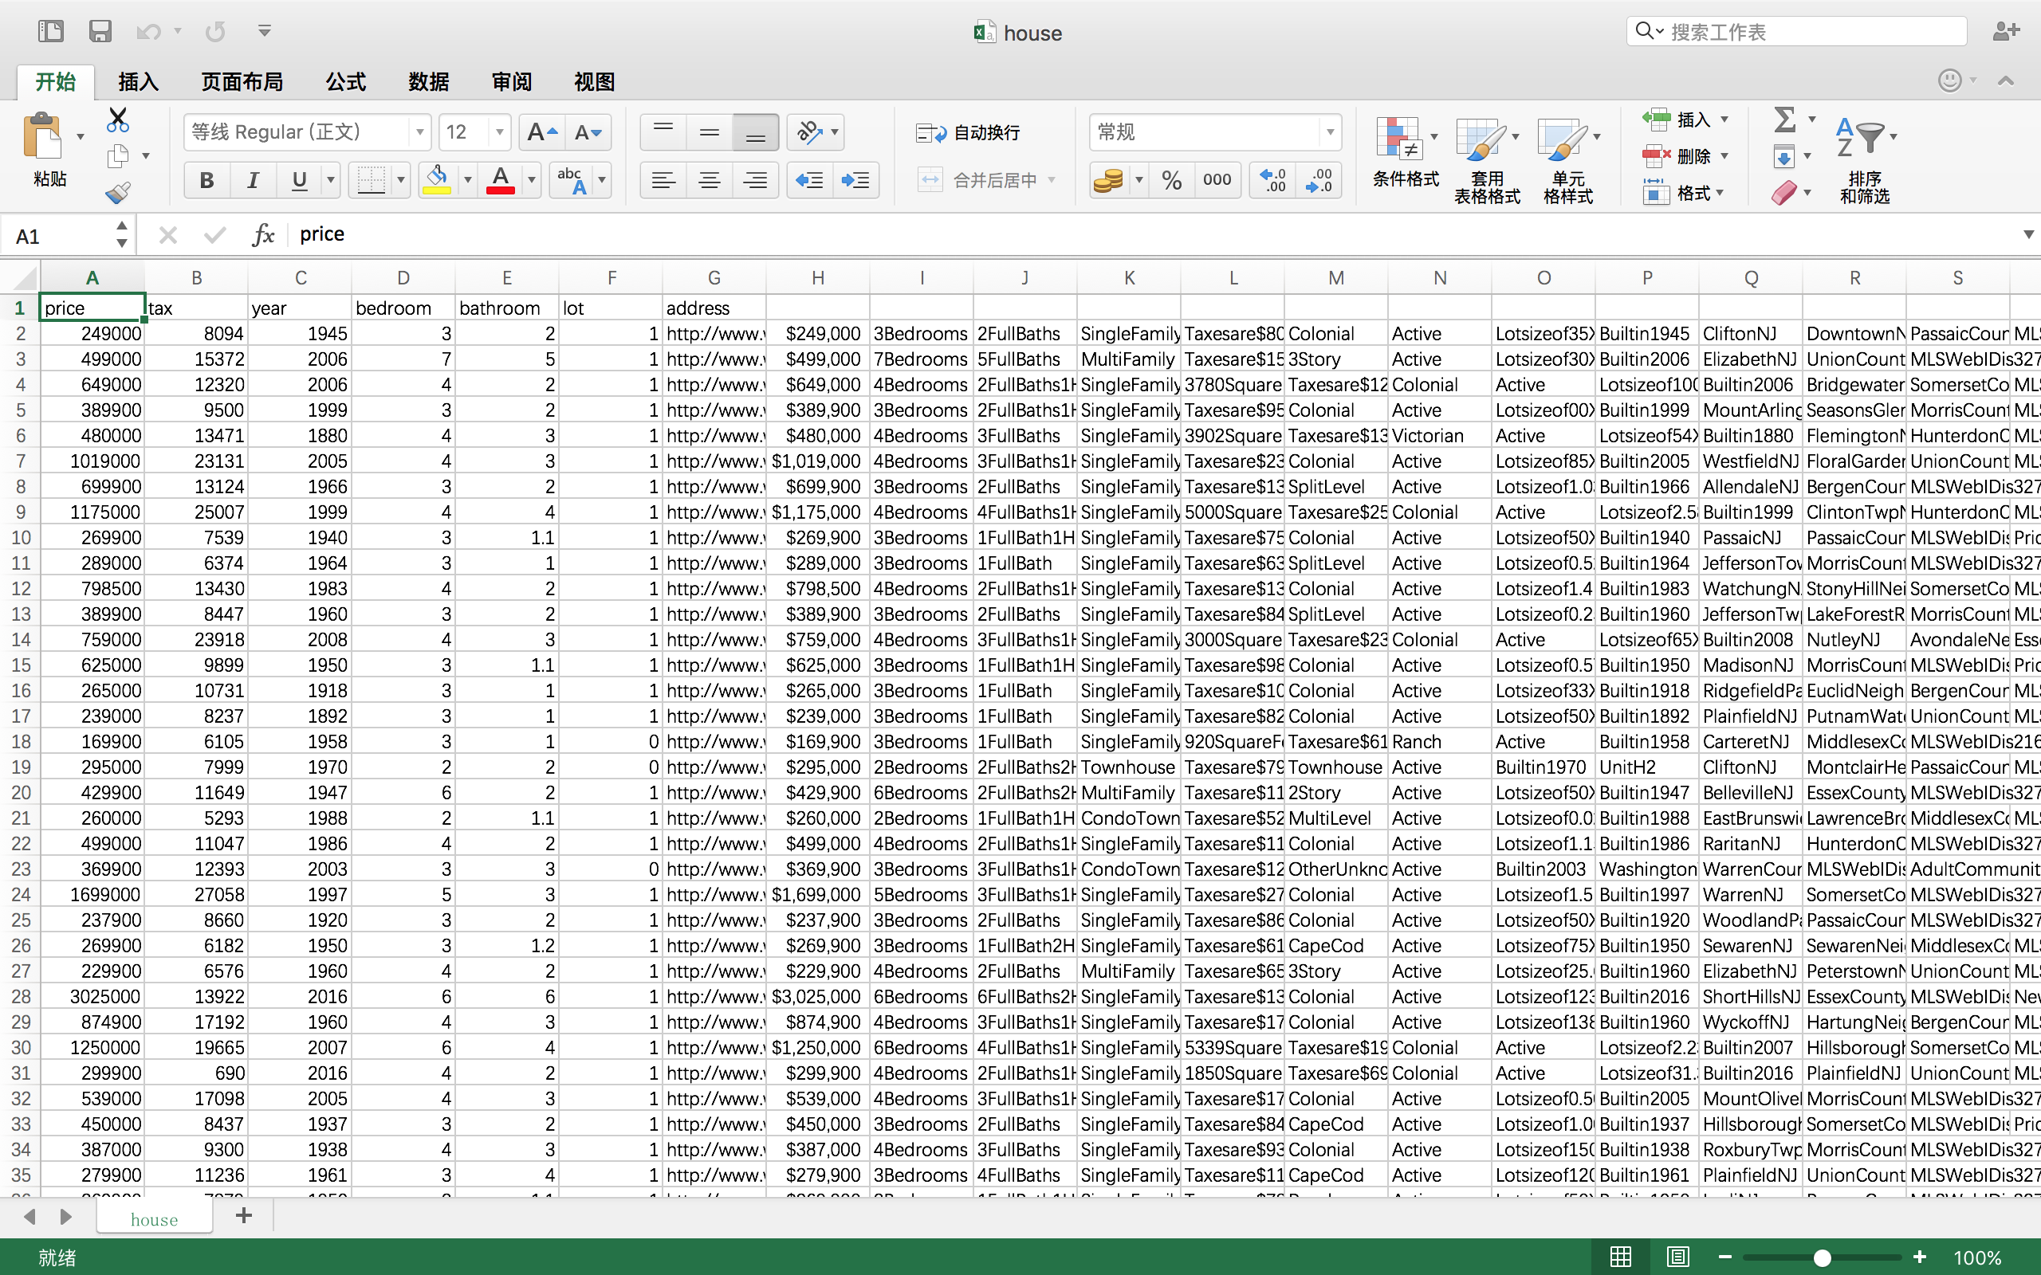
Project Procedure:
Data Process Unit: Since the information provided in the website is not arranged in a deterministic way, so that we need the uniform the style, and sort the information by increasing prices.
Unsorted information:

Slide 10
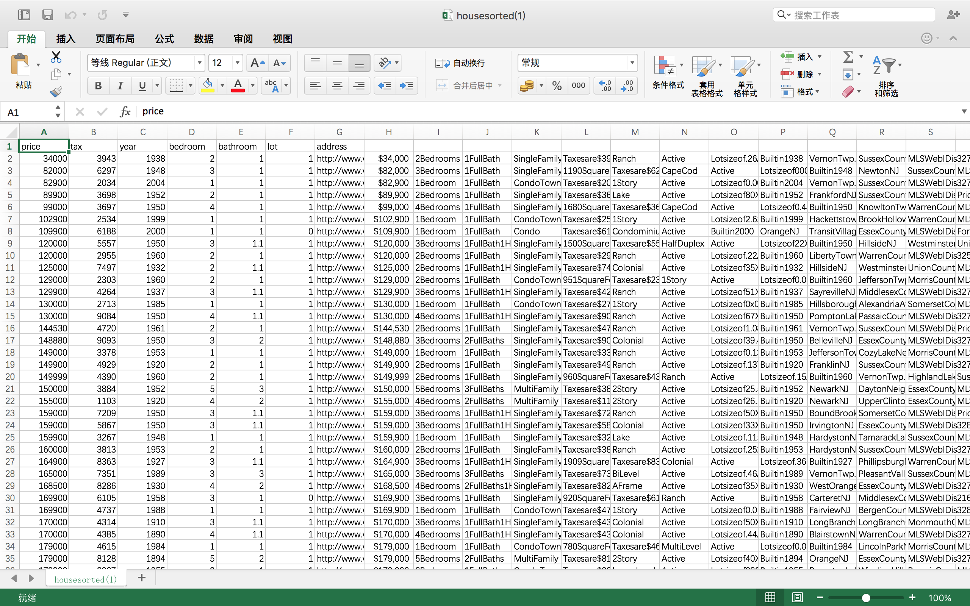
Project Procedure:
Data Process Unit: Since the information provided in the website is not arranged in a deterministic way, so that we need the uniform the style, and sort the information by increasing prices.
Sorted information:

Slide 11
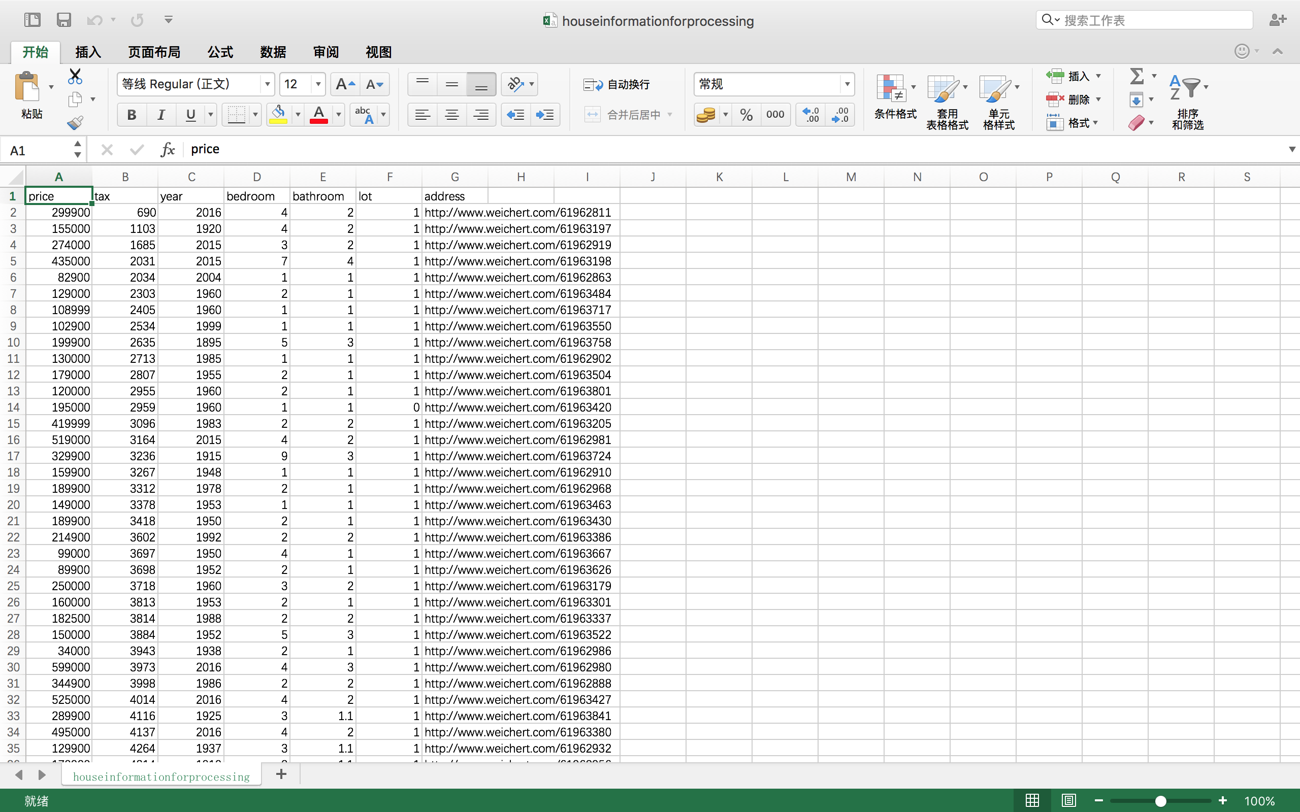
Project Procedure:
Brief version of the information which is used to give prediction.

Slide 12
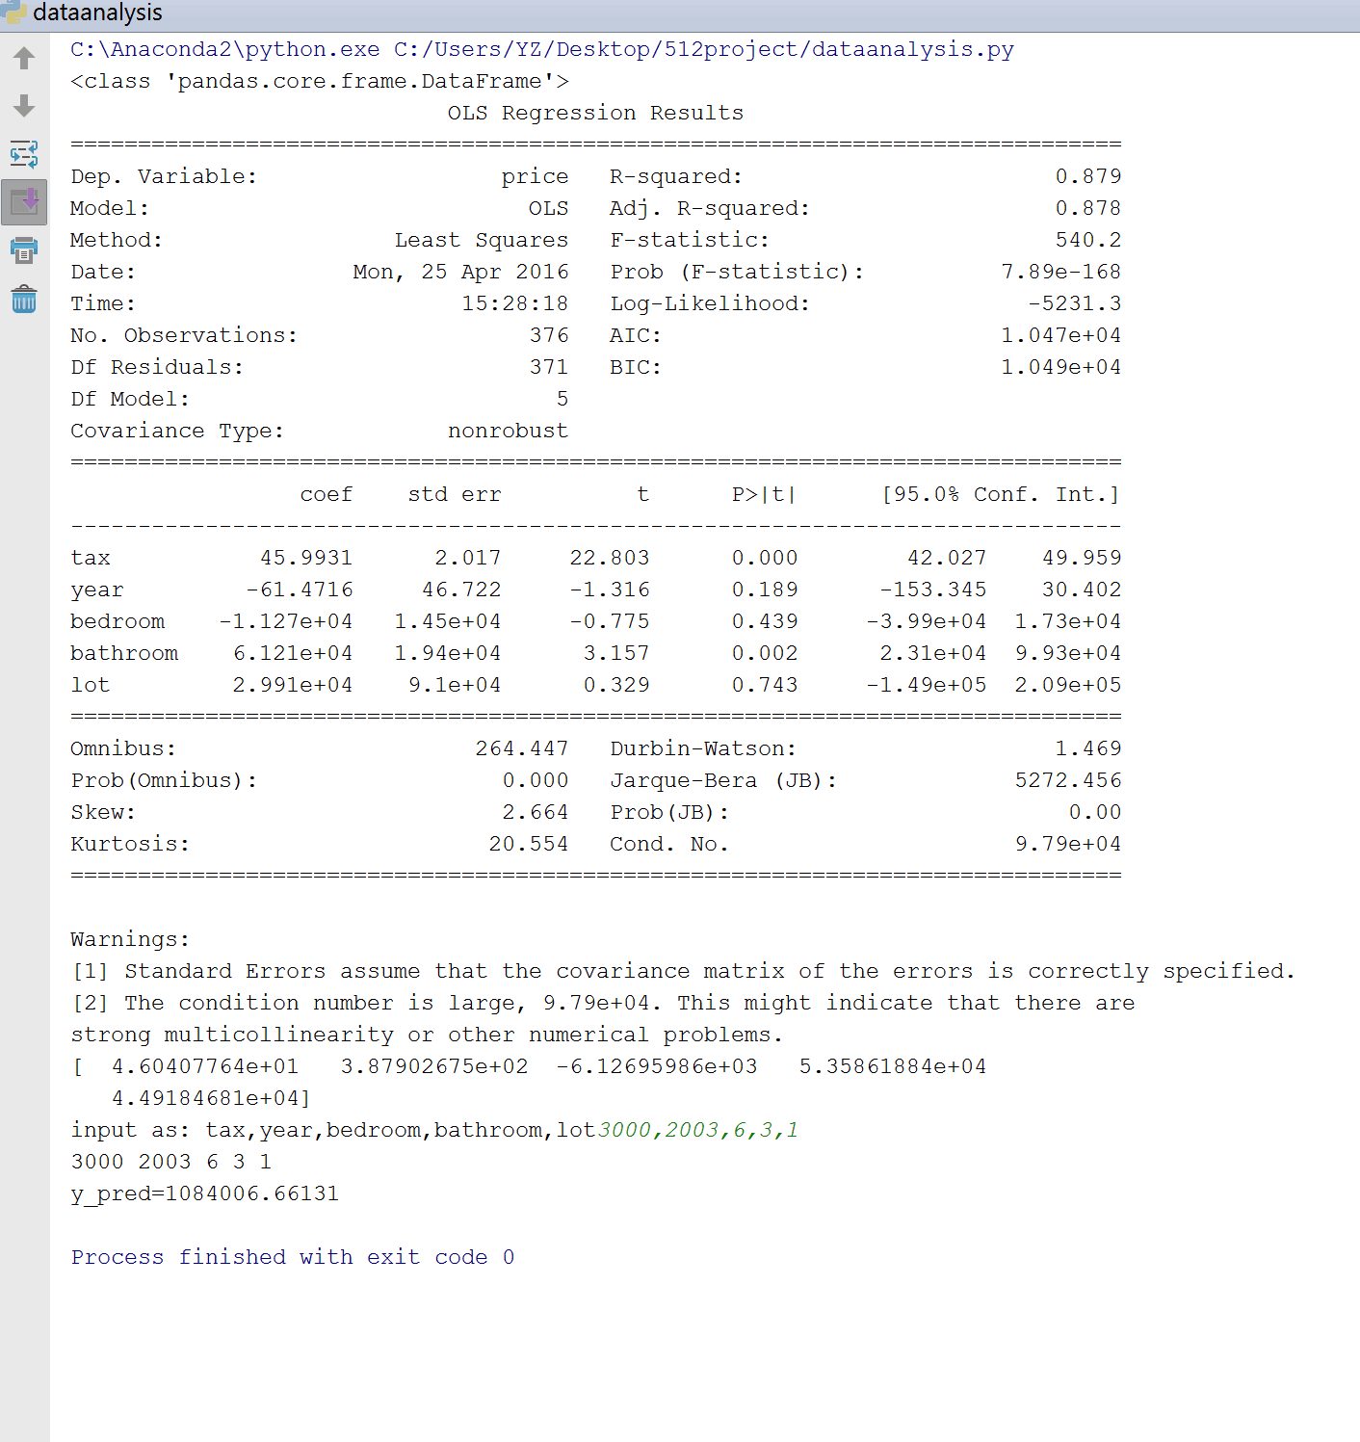
Project Procedure:
Output and Prediction: Multiple Linear Regression

Slide 13
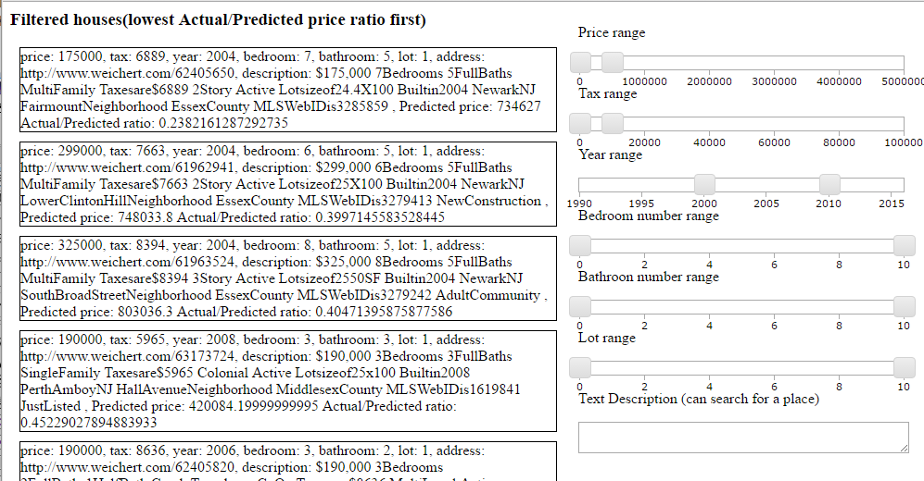
Project Procedure
UI Design: We design the user‘s interface using JavaScript. Users can input their preferences through sliders. Once the sliders are moved, different types of houses will pop up on the screen, listed in the order of how close with the ideal house.

